Slide 1
Projects Overview
Ecommerce Sentiment Analysis
Social media reach analysis
Project-1
Project-2
Ecommerce Sentiment analysis on the product reviews using natural language toolkit’s VADER lexicon model.
Gives an insights about the sentiments of the reviews and the overall sentiment of the dataset
A social media reach analysis tool to predict the reach of the social media account by accounting the interactions based on parameters like shares, likes, explore, saves, hashtags, etc.
Used skl’s passive regressor model for the analysis and identify number of unique users attracted.

Slide 2
P-1 Sentiment Analysis using ML
Introduction:-
Sentiment analysis on the eCommerce site’s product reviews dataset .
Analyzes the sentiment of the reviews and gives us the overall sentiment of the data in the dataset (for particular product category).
Resources used:-
Databricks ML flow (for leveraging ML operations and visualizations) , Kaggle (for review dataset)
Libraries used:-
Python:- Used to leverage the important library packages and write the code for the following.
Pandas :- Used pandas for converting the spark dataframe to pandas dataframe , allowing easy data manipulation and analysis using python.
Nltk:- Natural language toolkit was used to acces a predefined list of stopwords to filter out common, less informative words.
Performing stemming to normalize words and reduce them to their root forms, which aids in text analysis and ensures that different forms of the same word are treated as equivalent.

Slide 3
nltk.download('vader_lexicon') - Used to import the Vader lexicon model for sentiment analysis
re (regular expressions) - Used for pattern matching and text manipulation with regular expressions to search for patterns and perform text replacements.
plotyexpress :- Used to plot a pie chart of the ratings based on stars given.
Matplotlib:- Used to plot the word cloud (the most used important words).
plotly.graph_objects:- Used for providing a visual gauge chart for representing number of positive, negative and neutral sentiments and showing the overall sentiment.
Project link:- https://databricks-prod-cloudfront.cloud.databricks.com/public/4027ec902e239c93eaaa8714f173bcfc/2031680714864167/2974016621370095/7603771582229407/latest.html

Slide 4
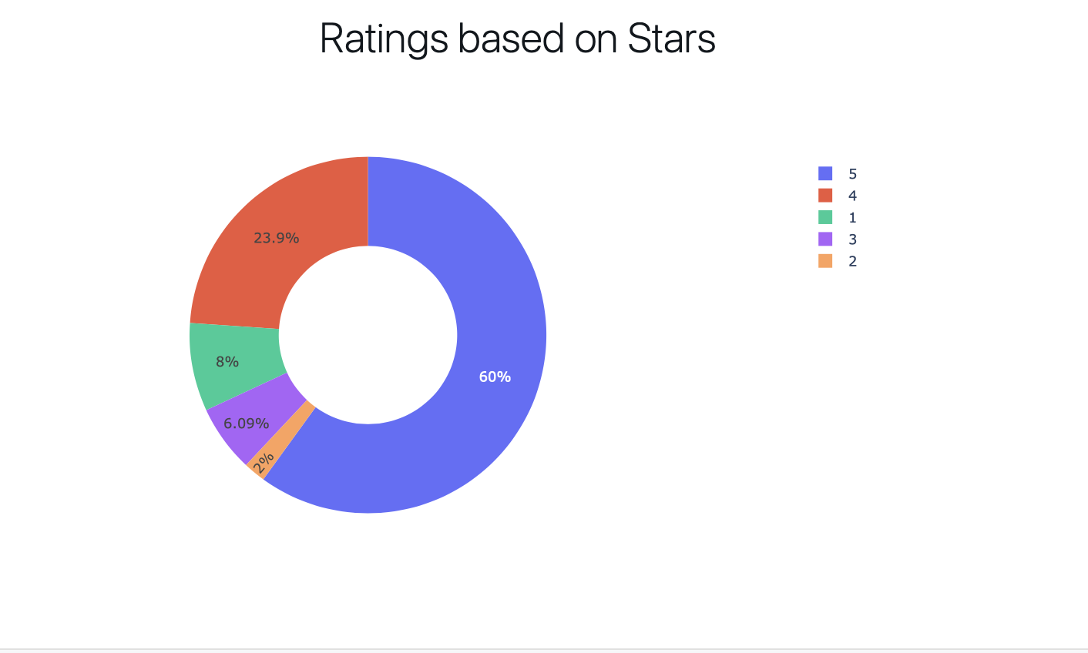
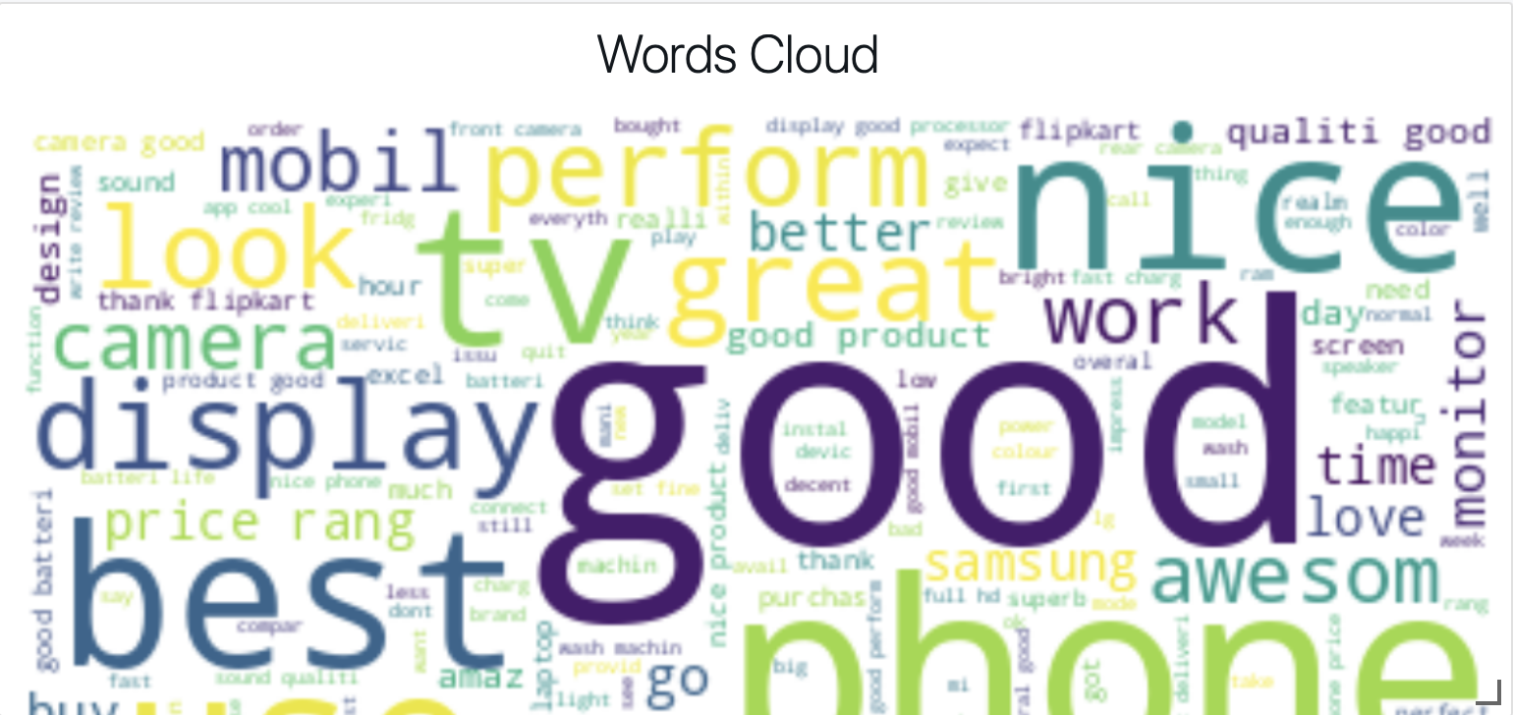
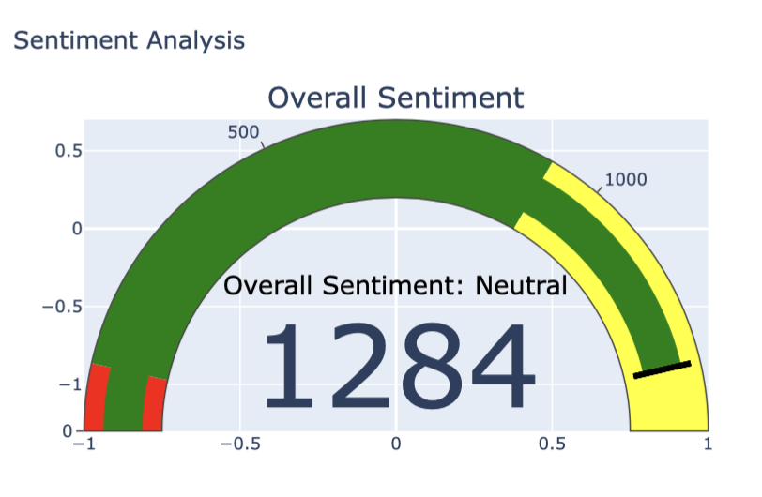
Dashboard Overview
Dashboard representing pie chart , plots, and an interactive visualization of overall sentiment.
Pie chart (using ploty express) is based on the ratings based on stars given in reviews.
Words cloud plot using matplotlib was formed using all the most used and important words.
The overall sentiment visual representation using ploty graph object library represents the overall sentiment value and

Slide 5
P-2 Social Media Reach Analysis
Introduction:-
Social media reach analysis to predict number of unique users based on the parameters like , shares, saves, hastags, likes, comments, etc.
Also provides a relationship of interactions with other parameters.
Resources used:-
Python:- Used to leverage the important library packages and write the code for the following.
Pandas :- Used pandas for converting the spark dataframe to pandas dataframe , allowing easy data manipulation and analysis using python.
pandas (pd): For data manipulation and analysis.
numpy (np): For numerical operations.
matplotlib.pyplot (plt): For static plotting.
seaborn (sns): For statistical data visualization.

Slide 6
wordcloud: For creating word clouds (not used in the provided code).
plotly.express (px): For interactive visualizations.
sklearn.model_selection.train_test_split: For splitting the dataset into training and testing sets.
sklearn.linear_model.PassiveAggressiveRegressor: For creating a passive-aggressive regression model.
Project link :- https://databricks-prod-cloudfront.cloud.databricks.com/public/4027ec902e239c93eaaa8714f173bcfc/2031680714864167/1785118742823927/7603771582229407/latest.html

Slide 7
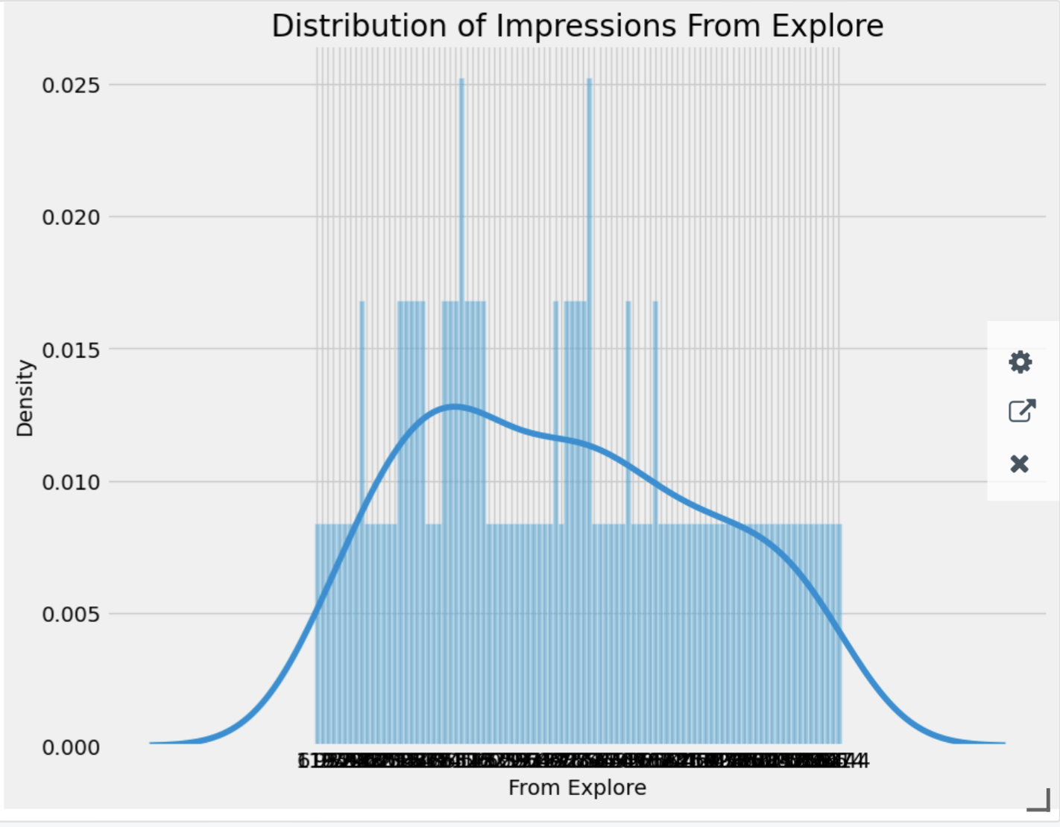
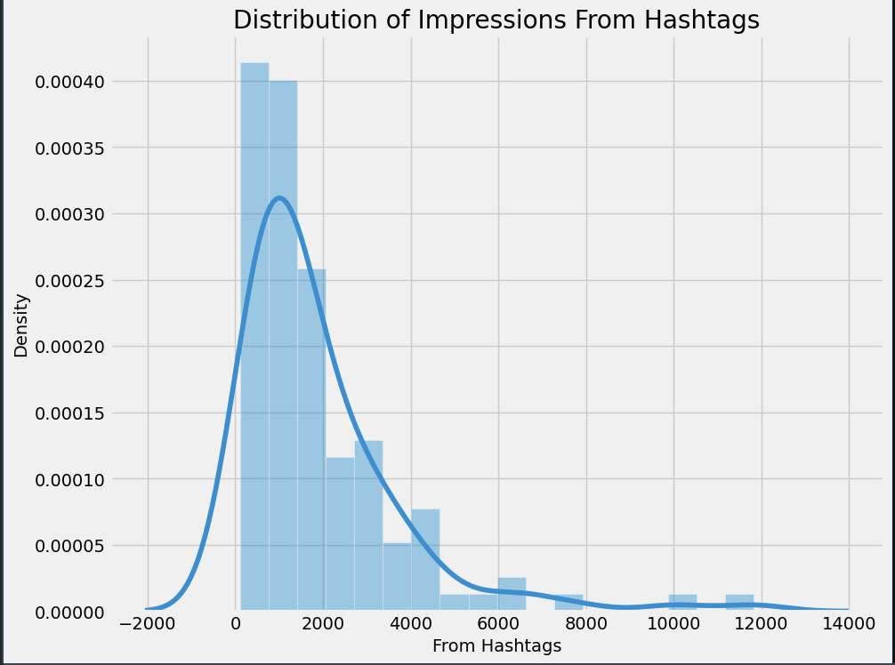
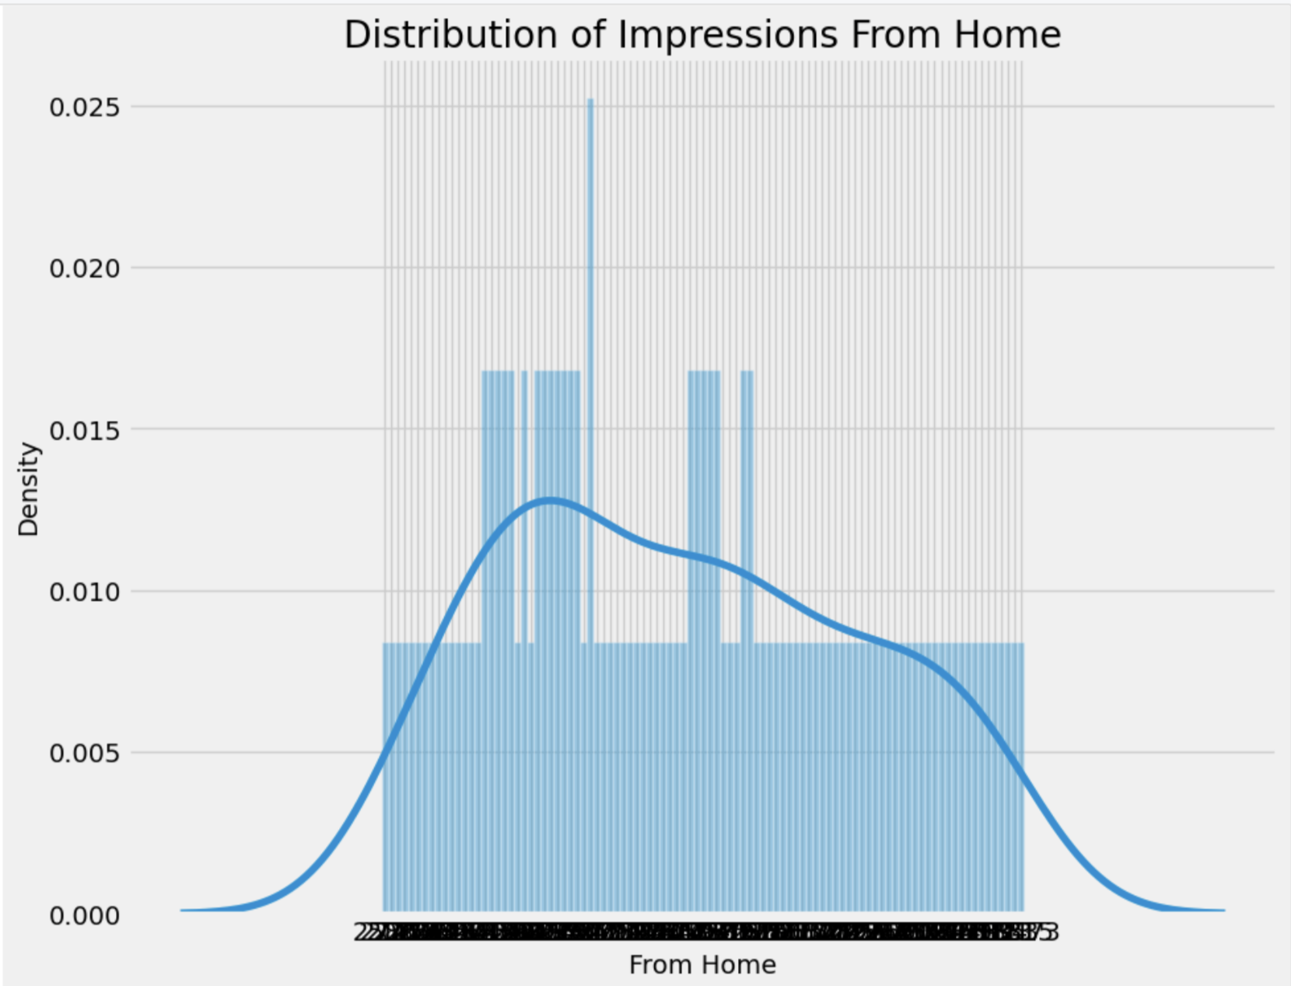
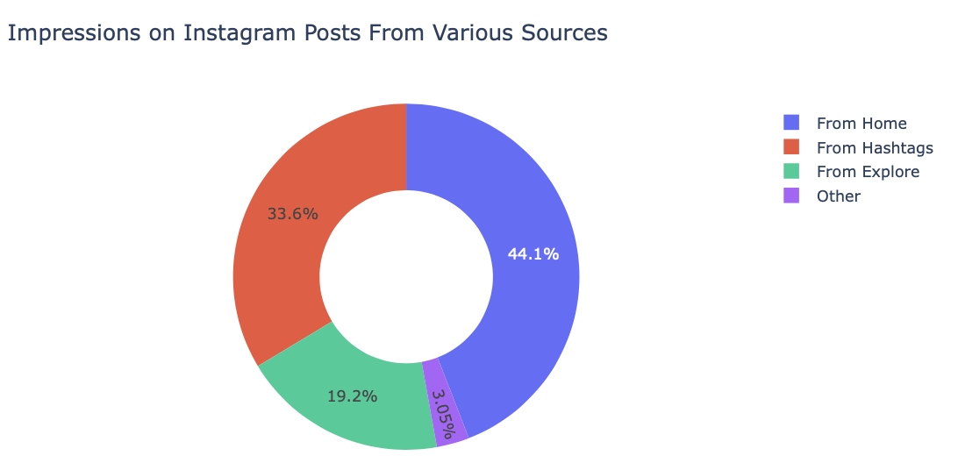
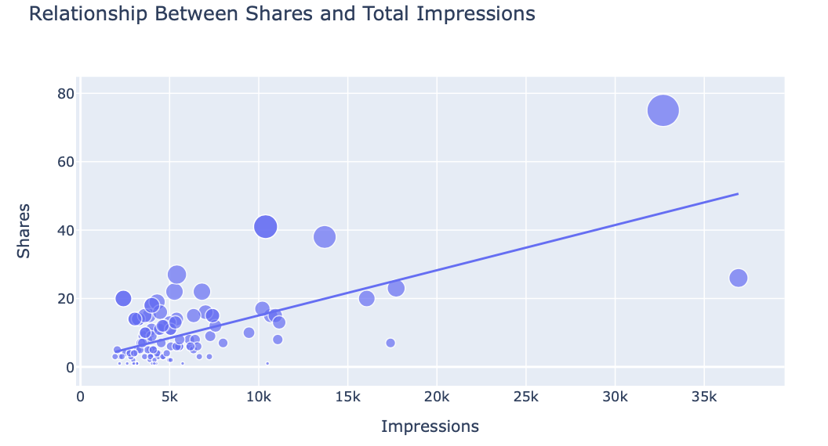
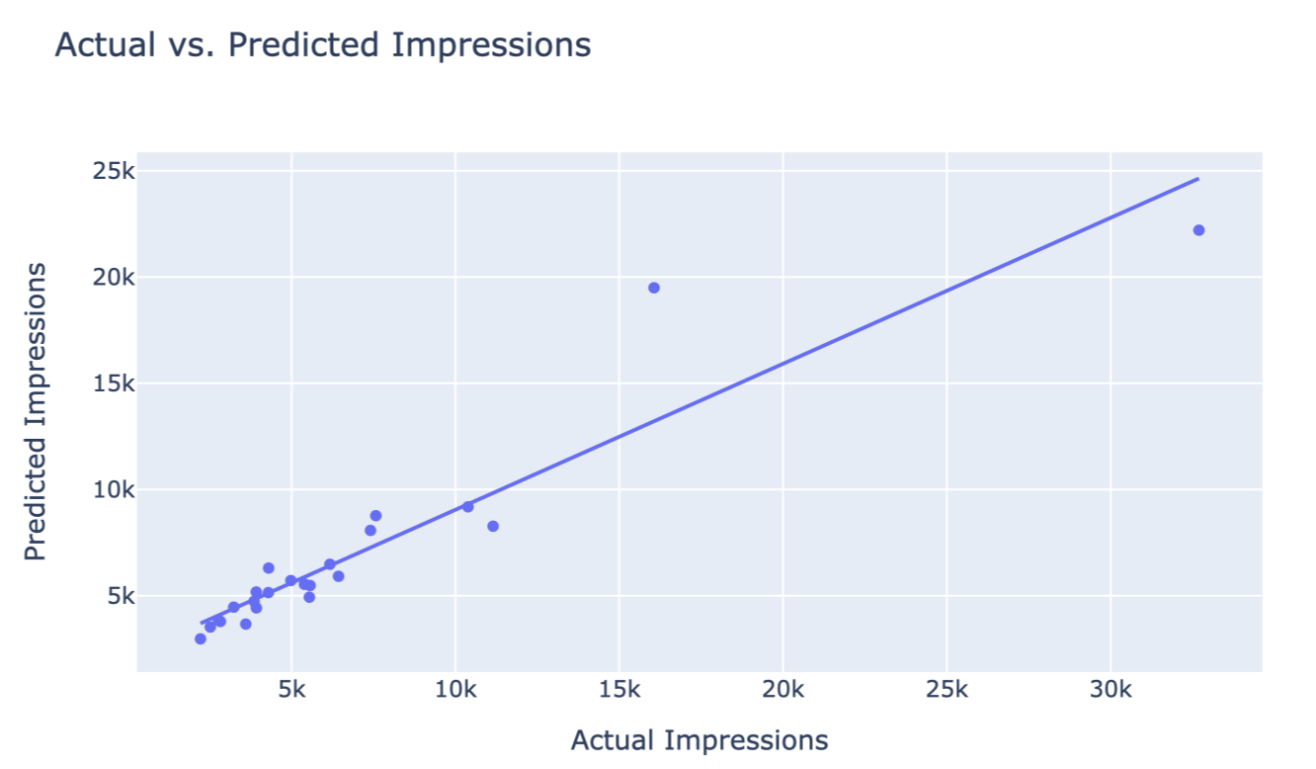
Dashboard Overview
Dashboard representing data analysis using various plots to understand the distribution of impressions and relationships between different engagement metrics like hashtags, shares, explore, etc.
Plot between actual and predicted impressions , showing the deviations and correct predictions made for the particular test case.

Slide 8
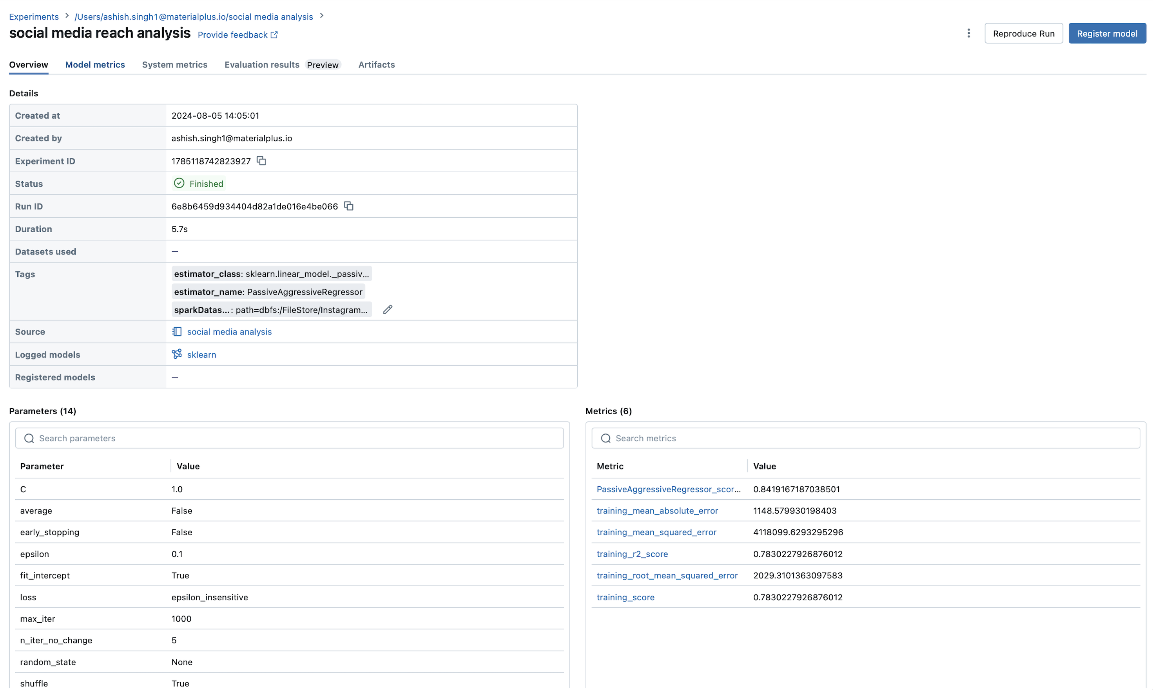
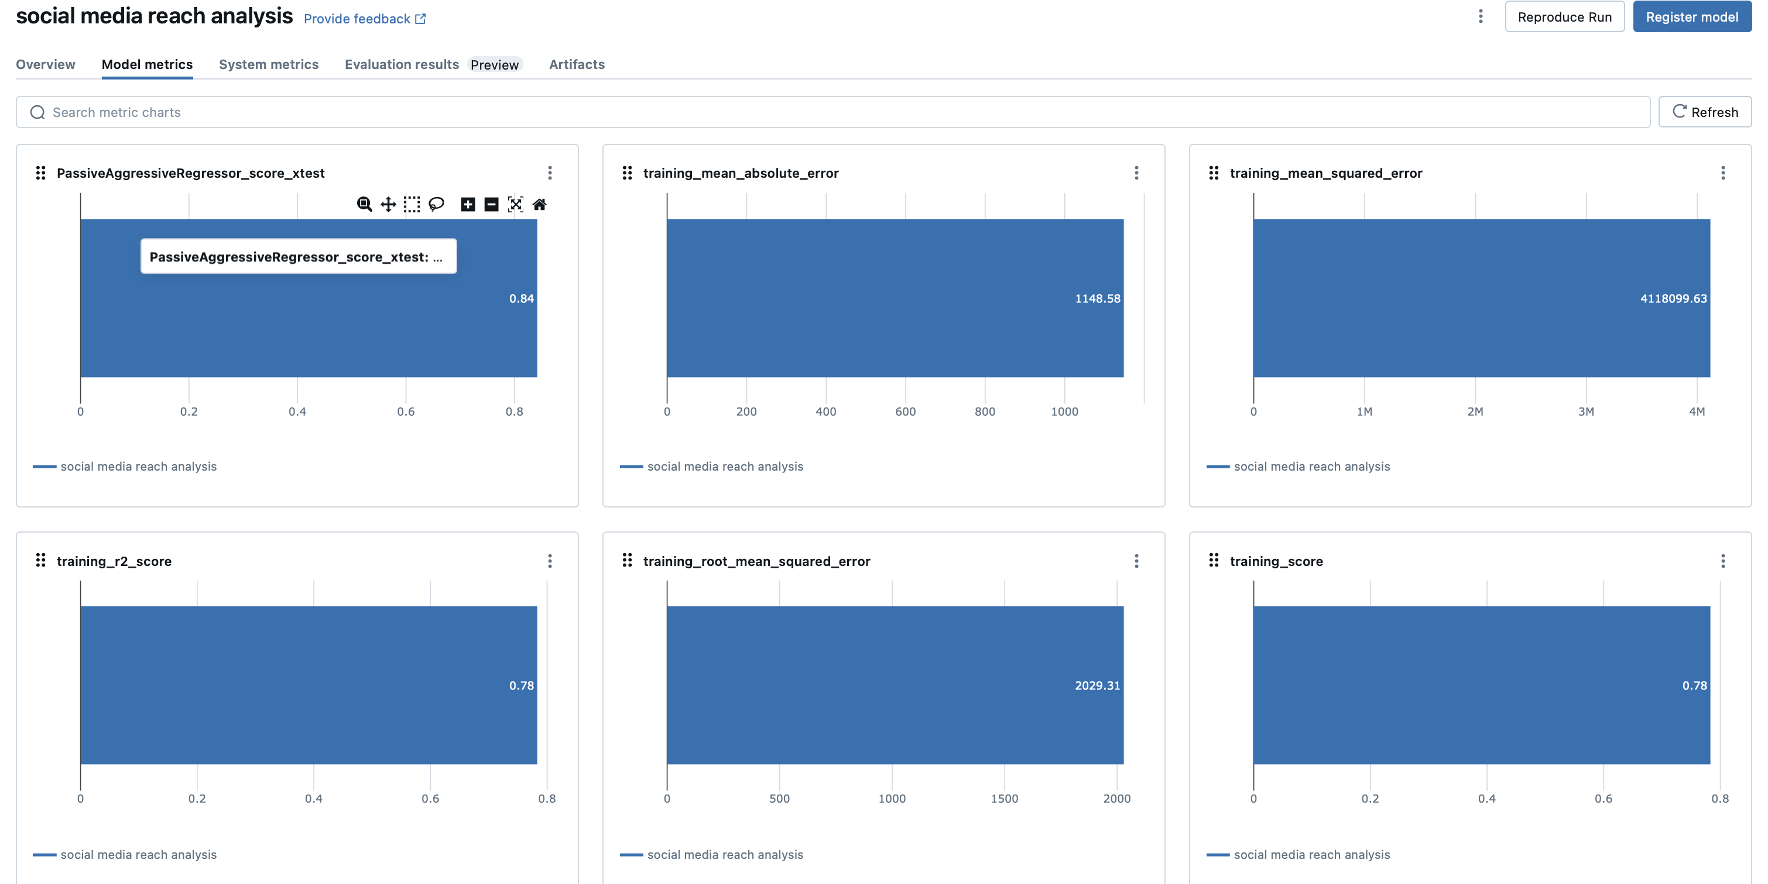
Databricks Experimental UI Overview

